Slide 1



GenAI for retail: Agent for seamless Onboarding & Smart sales
MISTRAL AI_
Hackathon X AI
Kick-off
November 23rd 2024

Slide 2

Agenda
Day
Time
Activity
Saturday 23/11
10h-11h
Challenge kick off
11h-12h
Setup and Team work
12h-13h30
Lunch
13h30-14h
Q&A session
14h-18h
Team work
Sunday 24/11
9h-12h
Team work
12h-13h30
Lunch
14h-20h
Team work
20h
End of the Hackathon
Wednesday 27/11
18h-19h
Final between pre-selected teams
19h15-19h30
Challenge results
QuantumBlack, AI by McKinsey
2

Slide 3
Introduction to QuantumBlack

Slide 4






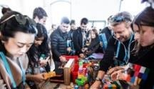



QuantumBlack, AI by McKinsey
Lancelot
McKinsey acquires QuantumBlack
QB/Labs: the AI center of learning & innovation
QB Quantum AI
Born in Formula 1
3
1
45
1
~800
>40
2009
2010-14
2015
2016 -20
2021
2022
2023
2024
Start-up mode
Accelerated growth
McKinsey’s unified AI arm
35
1
~450
16
~1,300
>40
Joined by
McKinsey & Company
4
Notes:
2009 - Born in Formula 1 : We were born and proven in Formula One, data has emerged as the fundamental element of competitive advantage
2010-2014 - Start-up mode : We grow by helping clients embracing AI/ML to solve business problems. We move from single use cases to end-to-end transformational thinking
2015 - McKinsey acquires QuantumBlack : We mix data science, design and engineering expertise with McKinsey’s industry knowledge and organisational change management experience
2016-2020 - Accelerated growth: We scale though investing in people, processes, and technology to deploy AI at scale quickly – serving 100s of clients across all industries
2021 - QB/Labs: the AI center of learning & innovation : We launch QB/Labs to reinvent client service with new tools and assets. We are focused on R&D, partnerships and innovation to optimize delivery
2022 & beyond : McKinsey’s unified AI arm : QuantumBlack is relaunched as the unified AI arm of McKinsey, bringing together 1,000+ technologists under a single community to drive sustainable and holistic impact for clients

Slide 5
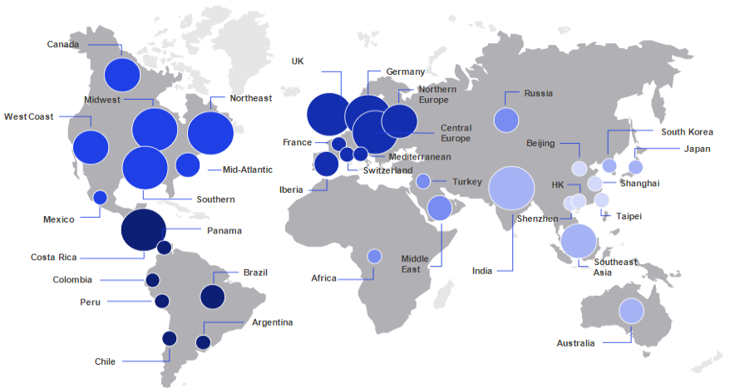




QuantumBlack today
Lancelot
1100+ Data Scientists supported by 5000+ Tech talent across the globe
Data engineering
Data science
Design
Tech delivery

Slide 6



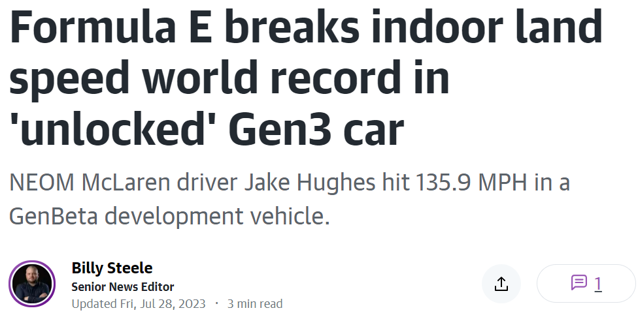

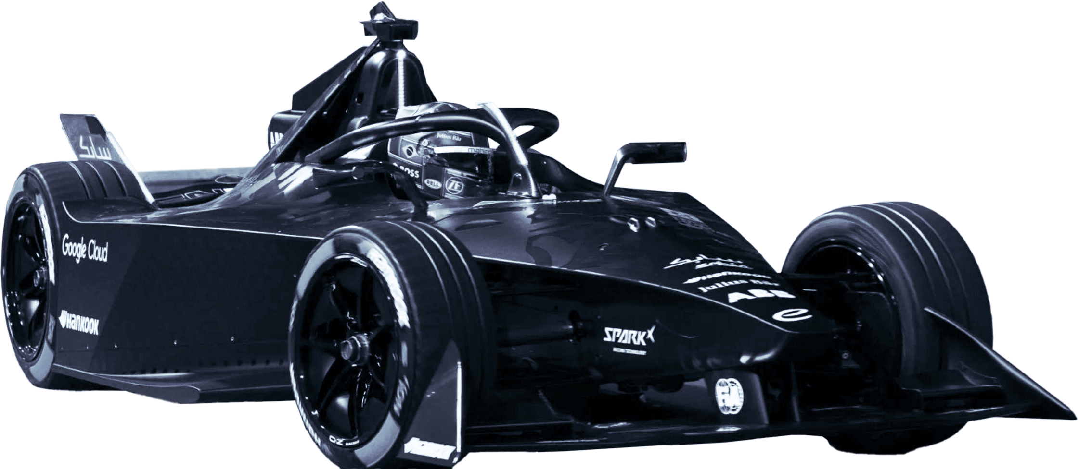
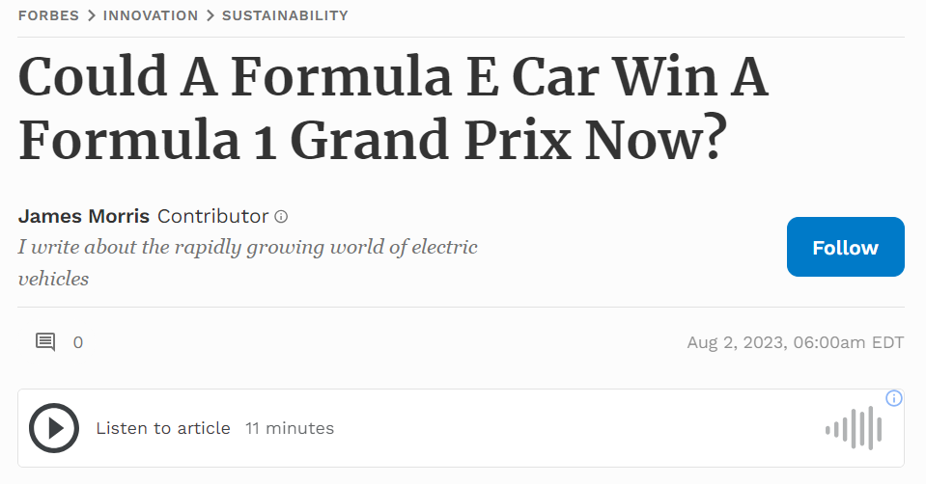
A world record for Formula E, propelled by QuantumBlack, AI by McKinsey
Lancelot
Example case
Context / Approach
Impact
Formula E built its new next generation electric race car, GENBeta, which it used to break the Guinness World Record for indoor land speed and drive marketing innovation
218.71 km/h
Guinness World Record for indoor land speed set
QuantumBlack launched 2 gen AI platforms in 2.5 weeks
40K+
fans attended the event and had the opportunity to chat with the gen AI ‘Fanbot’
Driver bot – Allowing ground team to query, uncover insights (e.g., did I over-steer?) and shape driving in real-time
Fan bot – Allowing fans “to speak with GENBeta” (e.g., How does your electric motor compare to a Ferrari?)
McKinsey & Company
6

Slide 7



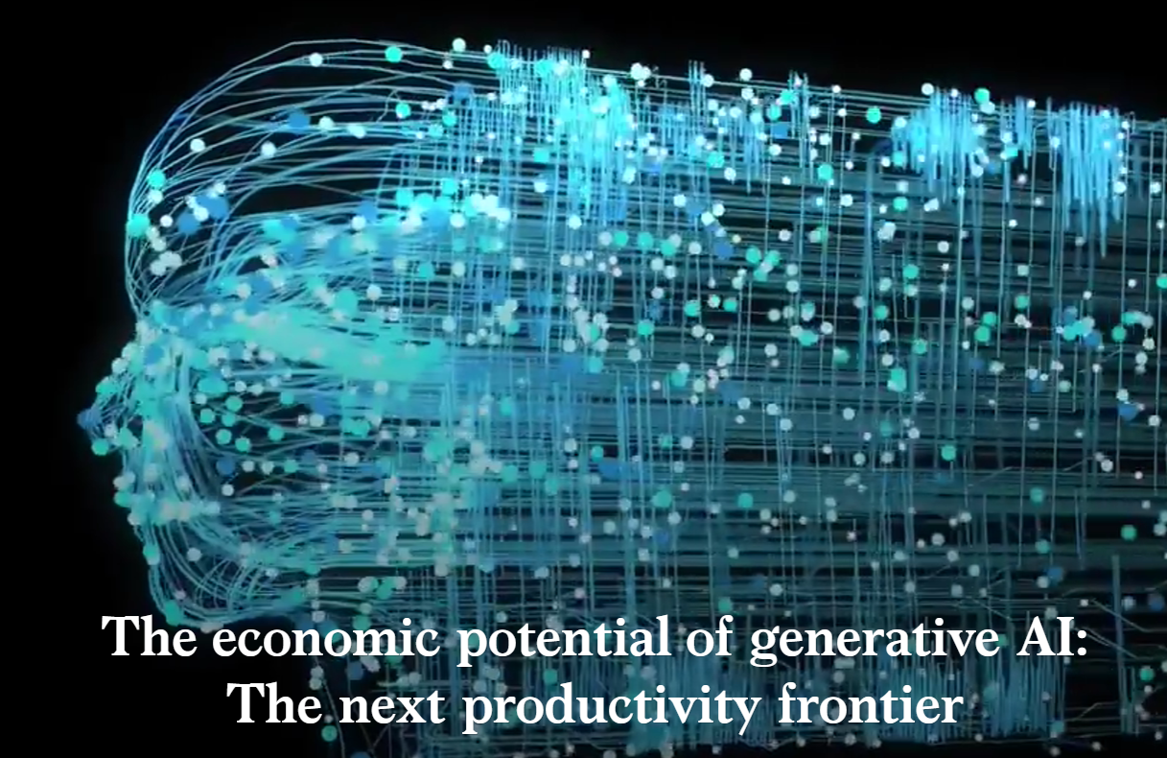
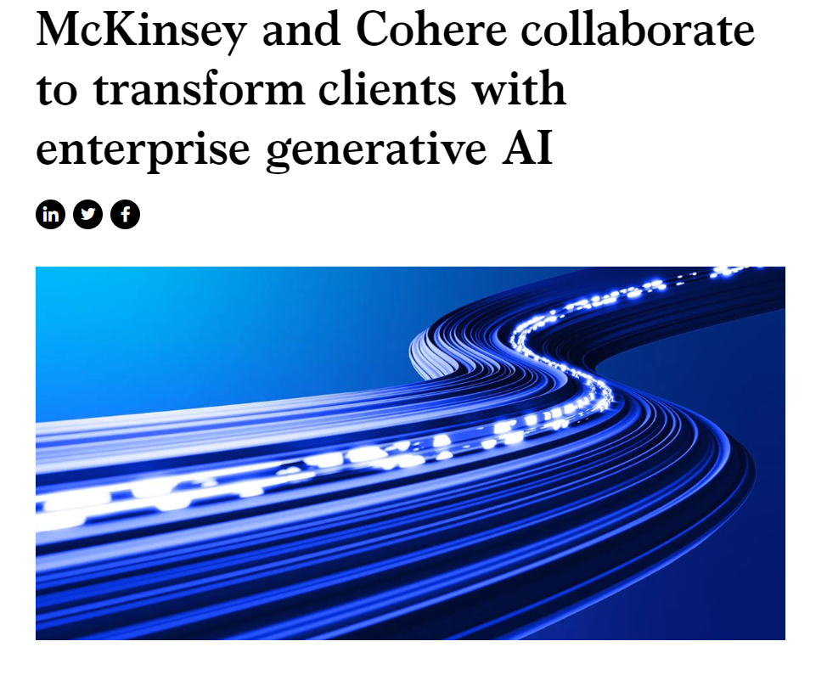
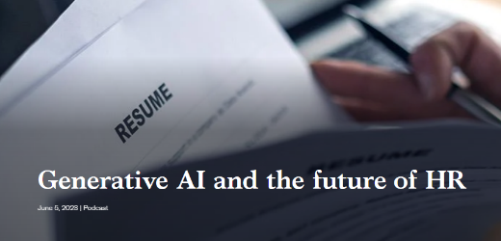

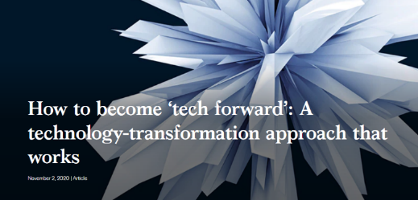
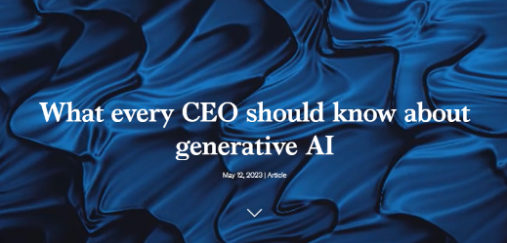
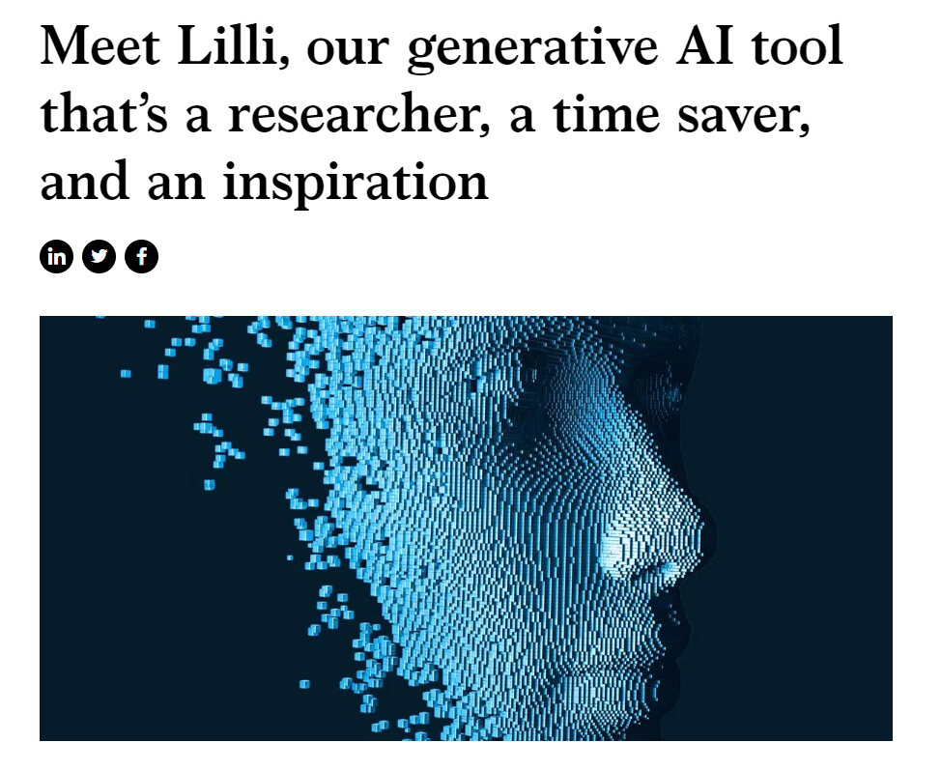

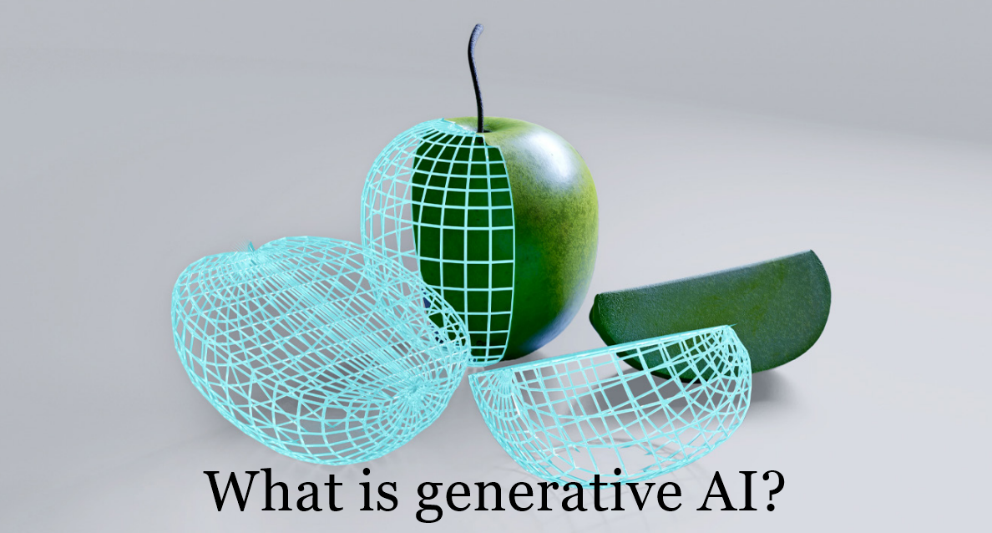

QuantumBlack thought leadership in all-things gen AI¹
Lancelot
Top 3
most read knowledge pieces of 2023 on McKinsey dot com
1,140+
media articles published, with 230 on key outlets
66%
share of voice compared to top competitors
~100M+
Impressions for gen AI content across Firm’s social and blog content
1. As of September 30, 2023
Source: CDFI Fund

Slide 8



Lancelot
Deep Learning Surrogates to design next-gen wind turbines
4 components to optimize (Stay vane, Guide vane, Runner, Draft tube)
~100 parameters
10+ constraints (cavitation, head centering, runner weight, pressure pulsation, …)
3 ML models merged with DLS workflow
6+ operating points predicted
400 000 CFP runs/ day vs 2 runs/ day
QuantumBlack, AI by McKinsey
8

Slide 9

Lean more about QB

Slide 10
Introduction to Mistral AI

Slide 11















Meet Mistral AI_ We bring AI into everybody’s hands
July-Nov 2024
On a mission to build the world’s most efficient LLMs and tools for developers and businesses all around_
April-May 2024
New best
small models
February 2024
Ministral 3B & 8B
December 2023
World’s most powerful OS model
NeMo 12B
May 2023
September 2023
X
Optimized models
v2
First mainstream SMoE¹ model
Updated with new state-of-the-art features
First open-source model
Founded
First code model
Multimodal models
Our conversational AI interface
Pixtral
Pixtral Large
>7M
downloads
Models for research
Codestral Mamba
Mathstral
1. Sparse Mixture of Experts

Slide 12



Mistral AI makes it easy for you
La Plateforme for developers
Backend solutions where we orchestrate generative AI apps and help you improve them
Le Chat for knowledge workers
Front-end solutions covering useful workflows in generative AI (chat for search / doc creation / automation)
Two connected products
The line between developers and users is thinning thanks to the intelligence of generative models

Slide 13
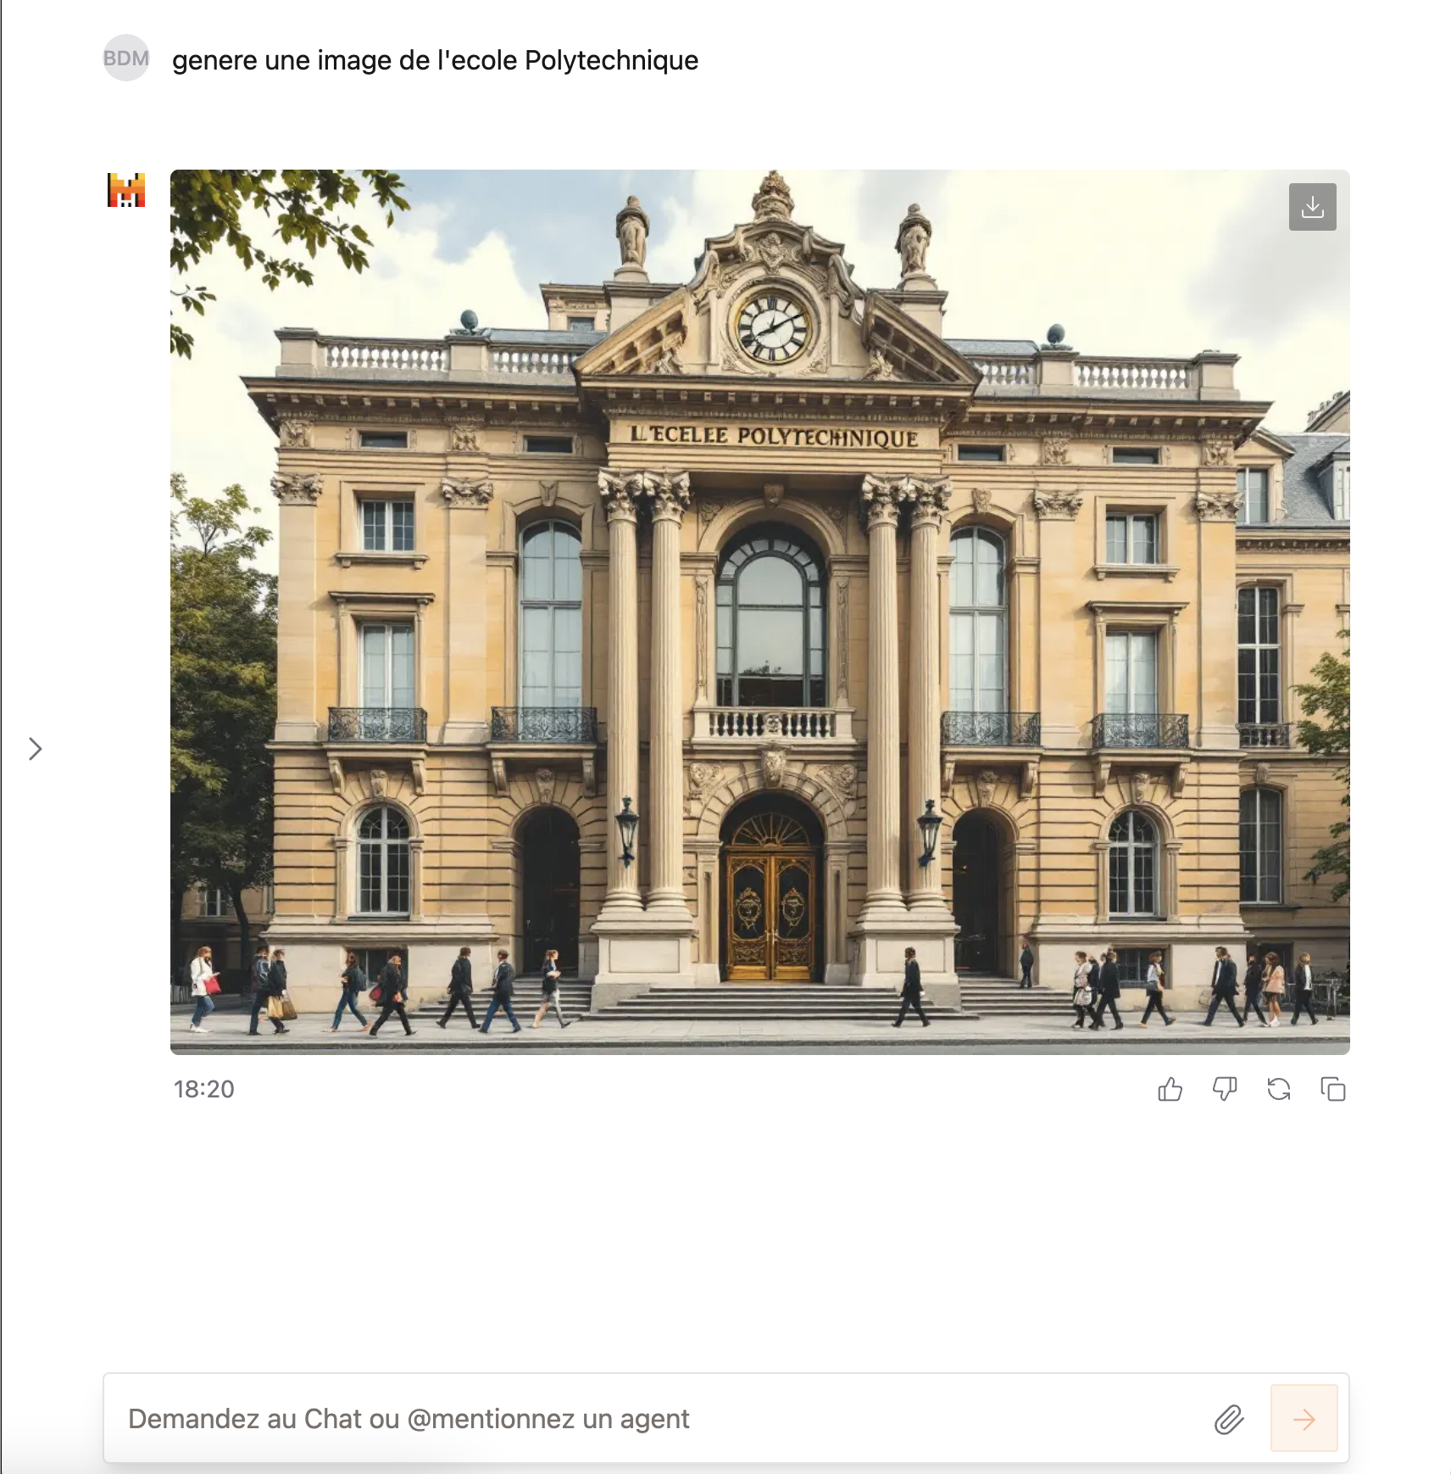
Le Chat Mistral
https://chat.mistral.ai
Access to latest models
Mistral Large 2 (123B)
Pixtral
Canvas
Image generation
Web search
It’s free!

Slide 14







Models
Latest
_Nemo
Our first model, fits on one GPU
Our SMoE model: only 14B inference
Our large SMoE model: for advanced research
Our state-of-the-art 12B model, built in collaboration with NVIDIA
Free
Research
_Mamba
_MathStral
Codestral Mamba, with in-context retrieval capabilities up to 256k token
MathStral, our model dedicated to research in STEM subjects
General models
Best for low latency, conversational use cases
Our flagship model, for your most sophisticated needs
Premier
Custom models
Codestral: A low-latency model for coding (80+ programming languages)

Slide 15
Challenge presentation

Slide 16
GenAI holds $6-8 trillion potential, amounting to 20-30% of total value from AI
Sylvanus
AI’s potential impact on the global economy, $ trillion
17.1-25.6
The AI total potential is still primarily driven by traditional analytics and AI use cases, with GenAI accounting for ~20-30% of the total AI potential
GenAI both allows for the creation of new standalone use-cases, but also enhances the potential of traditional analytics use-cases
6.1-7.9
11.0-17.7
~20-30% of total AI potential
Data, AA and traditional AI use cases
New GenAI use-cases + higher worker productivity by GenAI
Total AI economic potential
Deep-dive following
Source: McKinsey Global Institute
Notes:
Deux raison:
Social
Economique

Slide 17





















Retail is the second largest sector that has great potential in leveraging GenAI to drive significant impact
Generative AI productivity impact by sector Total Cost saving, $ billion
Generative AI productivity impact by function, Total Cost saving, $ billion
240-460
Marketing & Sales
91 - 138
240-390
Software Engineering
45 - 95
200-340
180-300
170-290
Customer Operations
49 - 67
160-270
150-260
150-250
150-240
120-200
120-230
Supply Chain & Operations
18 - 33
110-180
Risk & Legal
16 - 23
Strategy & Finance
10 - 21
Talent & organization (incl. HR)
5 - 8
High Tech
Retail
Banking
Travel, Transport & Logistics
Advanced Manu-facturing
Consumer Packaged Goods
Health- care
Administra-tive & Profession-al Services
Energy
Basic Materials
Education
Real Estate
IT
3 - 4
Total Retail Productivity Impact
240-390
Source: McKinsey report, The economic potential of generative AI: The next productivity frontier

Slide 18
We see various examples of use cases across the entire retail internal value chain
GenAI-powered use-cases, not exhaustive
Illustrative
xx
to follow
GenAI chatbots to handle initial communications and drafting e-mail messages to 3PLs
GenAI assistants for return management process and distribution disruptions
Smart assistants & coaches for store associates
GenAI-powered kiosks and displays
Content generation for marketing materials (e.g., written marketing and social media content)
Customer sentiment analysis via social media unstructured data (e.g., twitter, customer feedback)
Distribution
In-store operations
Marketing
Retail value chain segments¹
Procurement
E-commerce
Back-office
Contract analysis and insights generation
Automated contract drafting
Supplier negotiations chatbots to handle the initial round of contract negotiations
Generation of product listing and descriptions
Co-pilot for customer service agents
HR Q&A enabled search and question-answering (e.g., “how many vacation days do I have?”)
HQ support functions automation (e.g., draft job descriptions, legal contracts)
Co-pilot support for software development
End-to-end value chain: GenAI-enabled Trading AI system to suggest personalized and straightforward recommendations for every stakeholder
1. Commercial use-cases are not included due to limited potential for GenAI to be employed for commercial purposes
Source: McKinsey client examples
Notes:
Discover and launch drugs in weeks

Slide 19
However, few companies have been able to generate impact at scale
x%
Share of Net income attributable to the use of AI
Of organizations are considered as AI champions (i.e., ≥20% of Net Income attributed to the use of AI)
≥20%
~8%
≥5%
~18%
Are still lagging but achieving medium bottom-line impact from AI
Are considered as AI laggards failing to capture significant impact from their AI investments
<5%
~74%
Source: McKinsey State of AI 2022 survey – responses gathered from 1492 organizations, out of which 744 indicated they had adopted AI in at least one function and were asked questions about their organizations’ AI use
McKinsey & Company
19
Notes:
AI leaders also invest significantly more resources in AI, widening the gap with the rest of organizations
Respondents at AI high performers are nearly 8x more likely than their peers to say their organizations spend >20% of their digital-technology budgets on AI-related technologies.
These digital budgets make up a much larger proportion of their enterprise spend: respondents at AI high performers are over 5x more likely than other respondents to report that their organizations spend more than 20 percent of their enterprise-wide revenue on digital technologies.

Slide 20








Scaling GenAI requires a radical change on multiple dimensions vs the approach adopted for experimentation
Experimentation stage
Scaling phase
Strategy
Large number of use case investigated
Focus on limited number of high potential use cases
Robust business case (value levers and run cost)
Operating model
De-centralized or centralized (AI lab)
Federated Product & Platform operating model
Data governance for unstructured data
Tech expertise
Data scientist + Data Engineer
Cross functional team (Data scientist + Data engineer + ML/LLM Ops Engineer, AI Product Manager…)
Delivery approach
« Proof Of Concept » approach focused on checking tech feasibility and value creation potential
« Transformative » approach covering process reengineering, change management, tracking of adoption/value capture, GenAI application industrialization and proactive risk mitigation
Tech foundation
Standalone sandbox environment leveraging CSP off the shelf AI/GenAI services
Secured, scalable and flexible GenAI tech foundation (incl. Industrialized data pipeline & LLM OPs), enabling re-use
Enterprise acculturation
Understanding of AI/GenAI potential
Value capture at scale
Cost and environmental impact containment
Risk mitigation

Slide 21


RetailX
Axel
RetailX is a young French startup created in October 2024 . Our vision is grounded in the belief that AI can significantly enhance the efficiency and personalization of retail.
We aim to develop an AI agent platform that integrates effortlessly with any data source, providing a versatile and efficient solution for retailers. This vision is not just a technological aspiration but a strategic direction that reflects our commitment to innovation and customer-centricity.
Our product road map have already been defined and is articulated around 3 main functionalities: 1- Automated client onboarding 2- Real time order management 3- Personalized customer interaction
We need you deep expertise in LLMs to achieve this challenge !
Anna, founder of RetailX
Reinventing Retail: Smart AI Agents for Exceptional Customer Experiences

Slide 22








You just join RetailX – In the Meating room the team is brainstorming on the next steps…
Axel
Automated Onboarding: AI agent captures and organizes customer information, learns preferences, and guides clients through the onboarding process
Technical Stack
Key Milestones
Mistral LLMs models Mistral Small
Start-up contest Nov. 23th, 2024 – 9am
Order Management: AI tracks order statuses, manages stock levels, provides updates, and interacts with customers if issues arise.
Training product and review database
10min Pitch to investors *
Nov. 27th, 2024 – 7pm
Our vision is to bring…
Github repository
Personalized Customer Interactions: The AI uses data-driven insights to suggest products, answer FAQs, and offer discounts or loyalty perks.

Slide 23



To help RetailX, please provide ...
Axel
Code repository, including
Model developed
Model performance assessment
Runnable Web APP code
Pitch presentation [PPT – 10 mns]
Scientific approach
Web App demo. If you didn’t develop a web app, you can present a mock-up instead.
How are you going to use your app to drive positive impact ?

Slide 24
Grading criteria
Axel
Criteria
Score /100
Scientific approach quality and depth
20 pts
Scope covered
40 pts
Level 1 - Simple sales LLM model
20 pts
Level 2 - Cross sales LLM model
30 pts
Level 3 - LLMs + ML
40 pts
Business Pitch + App demo
40 pts

Slide 25
Deep-dive on business criteria: What will the final jury look for
Axel
You are trying to convince investors, try to be…
Elements of a great pitch
Examples related questions to ask
Concrete
What is the business model? Who are the clients?
Impact-driven
What are expected revenues? What is client experience impact?
Synthetic
What are your top 3 messages?
Simple
How can you translate technical elements in illustrations or demo?
Creative
What can differentiate you from your competitors?

Slide 26
Demo time

Slide 27
Mistral Models

Slide 28
Models
Latest
_Nemo
Our first model, fits on one GPU
Our SMoE model: only 14B inference
Our large SMoE model: for advanced research
Our state-of-the-art 12B model, built in collaboration with NVIDIA
Free
Research
_Mamba
_MathStral
Codestral Mamba, with in-context retrieval capabilities up to 256k token
MathStral, our model dedicated to research in STEM subjects
General models
Best for low latency, conversational use cases
Our flagship model, for your most sophisticated needs
Premier
Custom models
Codestral: A low-latency model for coding (80+ programming languages)

Slide 29
Mistral Large 2
Our most powerful model

Slide 30

Mistral Large 2
123B parameters
Strong multilingual support
Strong code & reasoning abilities
Advanced function calling
Open-weights for non-commercial usage

Slide 31
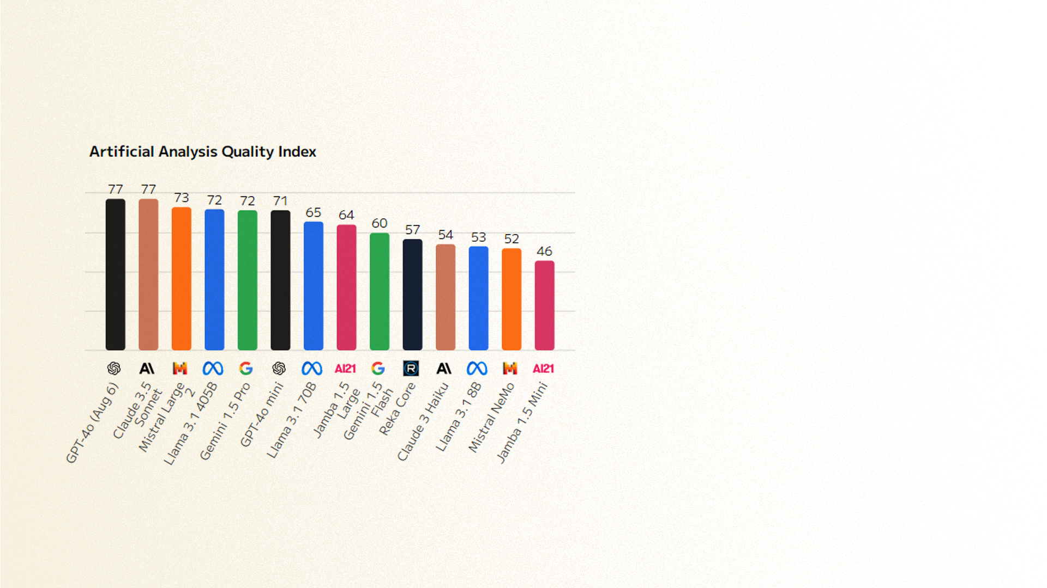
Mistral Large 2 – Performance
Artificial Analysis Quality Index measures average quality of models across multiple dimensions (general knowledge, science, coding, reasoning)
https://artificialanalysis.ai/models

Slide 32
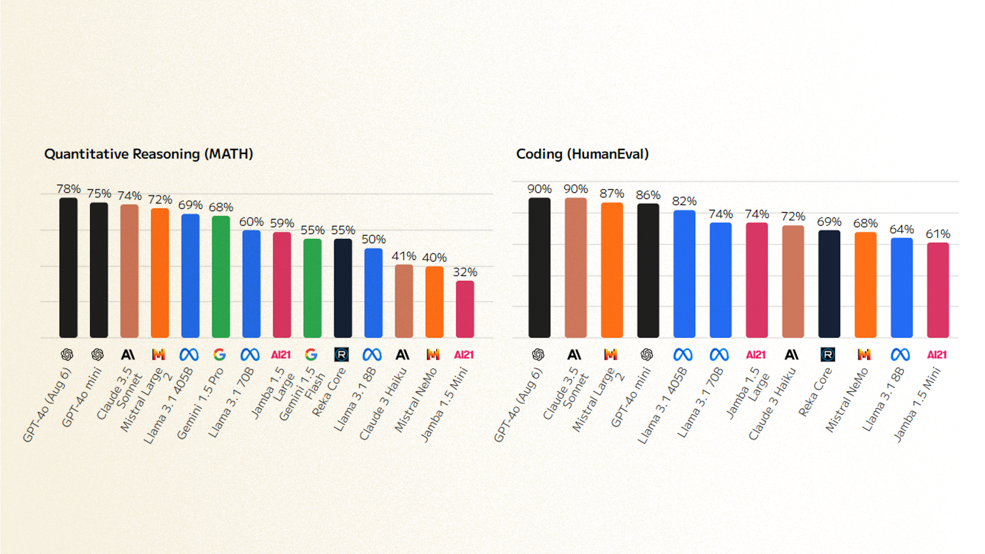
Mistral Large 2 – Reasoning benchmarks
https://artificialanalysis.ai/models

Slide 33
Mistral Small
Our best model for low latency conversational use cases

Slide 34
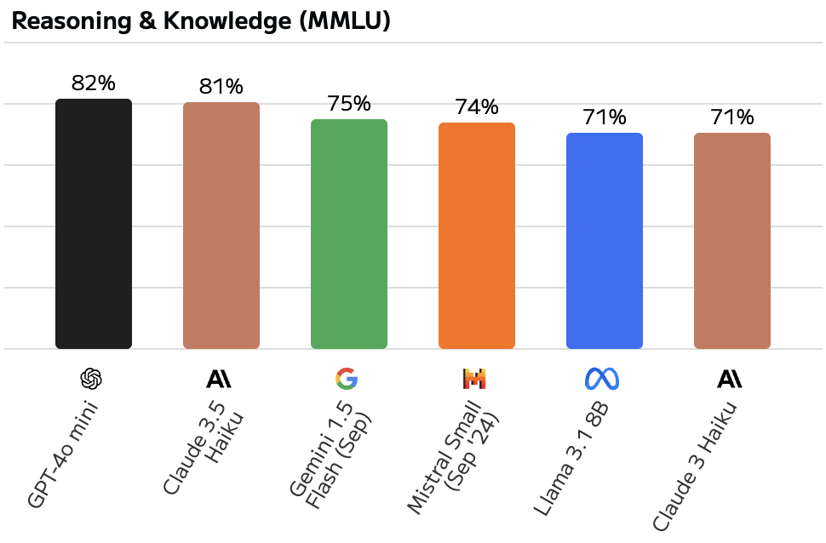
Mistral Small (24.09)
Cost-efficient, fast, reliable option
22 billion parameters for mid-point flexibility
Improved human alignment, reasoning, code

Slide 35
Fine-tuning

Slide 36



Mistral Small Fine-tuning
Mistral expertise
Pre-trains
Mistral general purpose Foundational Model
Several months on huge infra
Trillions of tokens
Further training
Domain-specific dataset
Sends specific queries
Responds
User
Fine-tuned LLM specialized to your specific domain
Notes:
FT small better than large
Difficult tasks : system prompt or few shot
Few shot = light fine tuning

Slide 37
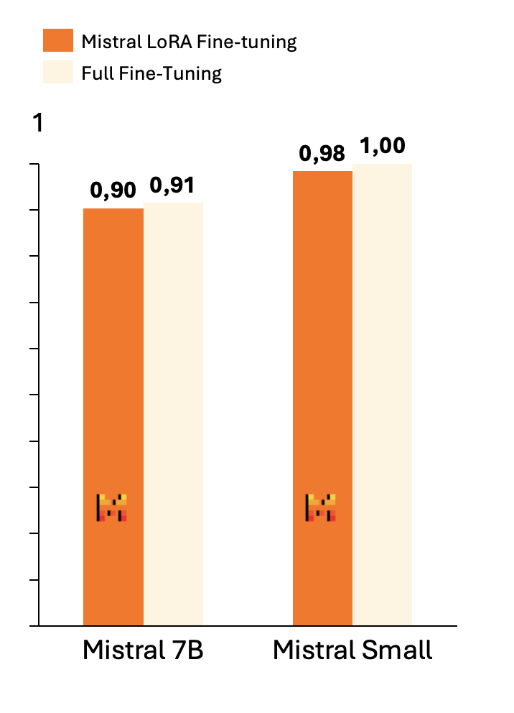
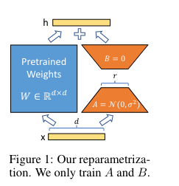
Fine-tuning: Under the hood
Adapter
USER: Cheese
ASSISTANT: Creamy delight, oh cheese.
Melting in warmth, you appease.
Flavors dancing with ease.
Hu et al., 2021
Base model
Adapters: small set of model weights created during fine-tuning to specialize a base model
Low-Rank Adaptation (LoRA): freeze base model weights + overlay with thin layer of trainable parameters.
Identical performances, lower cost

Slide 38
Benefits of Fine-tuning
Performance
Fine-tuned smaller models can outperform larger ones
Speed and Cost
Small models provide faster inference
Easier to deploy
Reduce token consumption at inference time
Flexibility
Different fine-tuned models for different use-cases
Mistral-finetune codebase
La Plateforme’s fine-tuning API

Slide 39
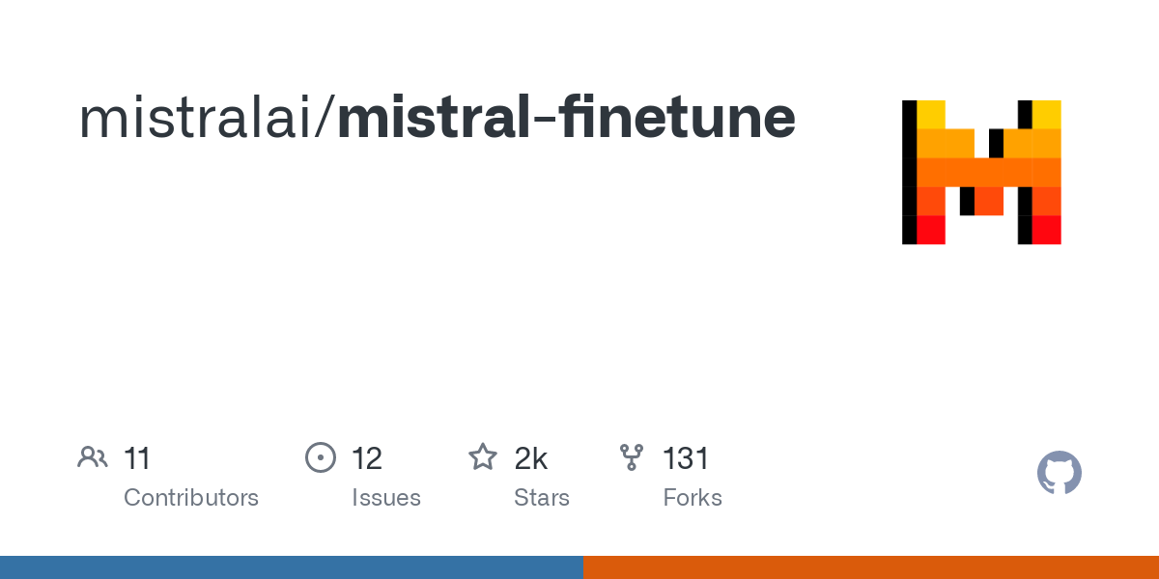
Fine-tuning
Open-source Library
Fine-tuning API on La Plateforme
https://github.com/mistralai/mistral-finetune
https://console.mistral.ai/
Mistral Large 2 can be fine-tuned with our mistral-finetune library or on La Plateforme
Notes:
Imagine large with finetuning

Slide 40







How to use our models
What our models do
What it could mean for you
NOT EXHAUSTIVE
Text generation
Personalized marketing generation
Summarization & insights generation (e.g., feedbacks)
Meeting minutes and follow-up email generation
24/7 customer chatbot
Intent recognition in call centers
Multi-lingual virtual assistant
Document translation
Multi-lingual customer chatbot
Multi-lingual
Coding copilot
Code documentation
Legacy IT modernization
Application development co-pilot (JSON mode)
Coding
Sales copilot
Customer agent support
Internal knowledge assistant
Advanced customer chatbot
On-field agent support
RAG
Function calling
Virtual expert with API calls to the ecosystem (live data or enterprise apps)
Automate complex workflows (e.g., credit risk assessment, claims processing)
COMPLEXITY

